Slide 1

Study on Large-scale Software Projects in the Last Decade: Lessons to Learn from Experience
Anindya Iqbal
Professor
Department of Computer Science and Engineering (CSE)
Bangladesh University of Engineering and Technology (BUET), Dhaka, Bangladesh

Slide 2
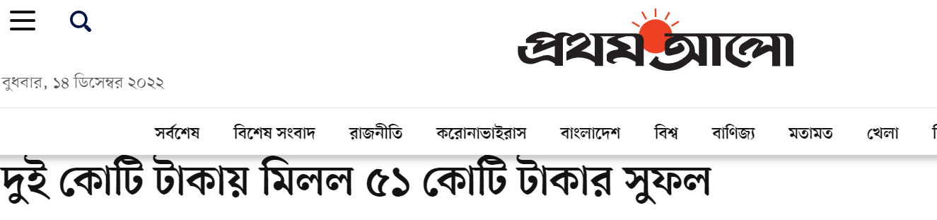
Online Tax Return
৫১ কোটি টাকা খরচ করে ২০১৬ সালে অনলাইনে আয়কর রিটার্ন জমা দেওয়ার ব্যবস্থা চালু করা হয়েছিল, যা ২০১৯ সাল পর্যন্ত চলে। এই প্রকল্পের ভিয়েতনামি ঠিকাদারি প্রতিষ্ঠান কাজ বুঝিয়ে না দিয়ে চলে গেছে। এরপর আর কেউ অনলাইনে রিটার্ন জমা দিতে পারেননি।
২০২০ সালের নভেম্বর মাসে জাতীয় রাজস্ব বোর্ডের (এনবিআর) আয়কর বিভাগের একটি বিশেষ দল নতুন অনলাইন ব্যবস্থা উদ্ভাবন করেছে। এ জন্য এনবিআরের মাত্র দুই কোটি টাকা খরচ হয়েছে। ফলে এই মৌসুমে আবার অনলাইনে নিবন্ধনসহ আয়কর রিটার্ন জমা দেওয়ার ব্যবস্থা চালু হয়। এতে করদাতারাও ব্যাপক সাড়া দিয়েছেন। ৫১ কোটি টাকা ব্যয়ের চেয়ে মাত্র দুই কোটি টাকা খরচেই মিলল বড় সুফল।

Slide 3
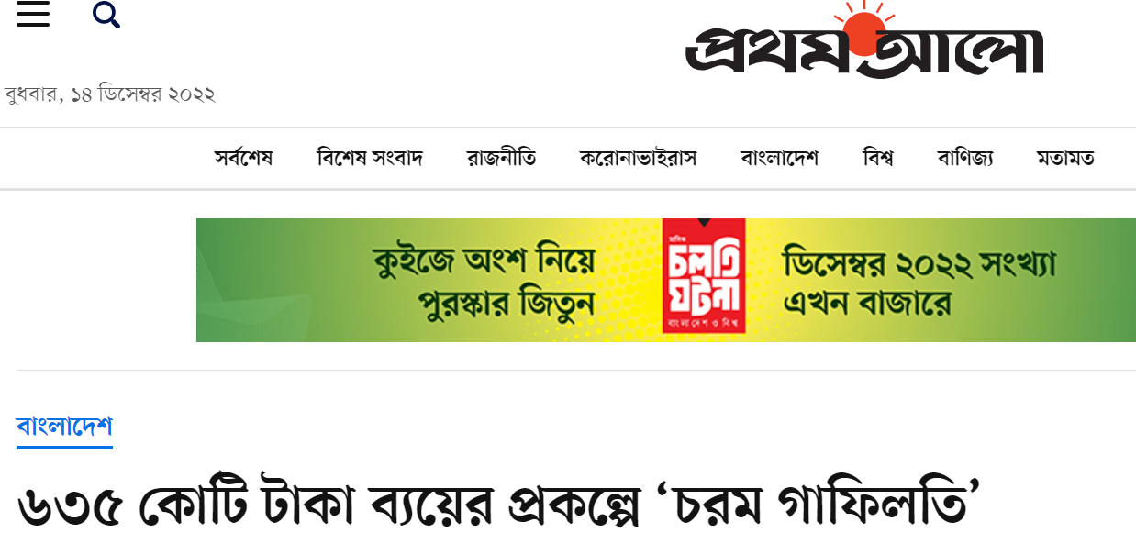
জাতীয় খানা তথ্যভান্ডার (ন্যাশনাল হাউজহোল্ড ডেটাবেজ বা এনএইচডি) project, started in 2013
প্রকল্পের অধীনে ২০১৭ সালে দেশের সব খানার (৩ কোটি ৬০ লাখ) তথ্য সংগ্রহ করা হয়। সংগৃহীত তথ্য ডিজিটাল ব্যবস্থায় সংরক্ষণ করার কথা। কিন্তু এখন পর্যন্ত সফটওয়্যারটি তৈরি হয়নি।
পরিসংখ্যান বিভাগের সচিব শাহনাজ আরেফিন প্রথম আলোকে বলেন, ‘মাঠ থেকে তথ্য সংগ্রহ করে আমরা বসে আছি। কিন্তু সেটি সফটওয়্যারে আপলোড (সংরক্ষণ) করতে পারছি না। দুর্যোগ ব্যবস্থাপনা অধিদপ্তর কবে সফটওয়্যার তৈরির কাজটি করতে পারবে, তারও নিশ্চয়তা নেই।’
সফটওয়্যার তৈরির কাজটি পেয়েছে আর্মেনিয়ার কোম্পানি সিনার্জি ইন্টারন্যাশনাল সিস্টেম। ২০১৮ সালে তাদের এ দায়িত্ব দেওয়া হয়। দুর্যোগ ব্যবস্থাপনা অধিদপ্তর বলছে, করোনার কারণে প্রতিষ্ঠানটির কর্মকর্তারা নিজ দেশে চলে যান বলে কাজ পিছিয়ে যায়।

Slide 4
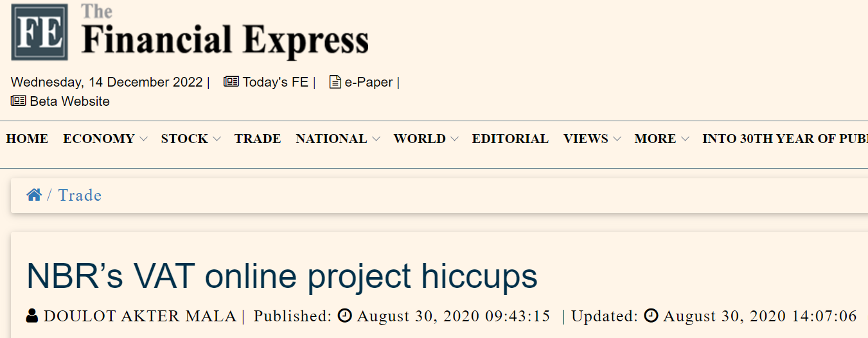
VAT Online: around 700 crore BDT project
Less than 50 percent big companies have submitted their VAT returns online - Large Taxpayers Unit (LTU) under NBR.
“Unless the VAT online project addresses the design flaws in the return module and the capacity constraints, large taxpayers will continue to face the problem”-LTU commissioner Wahida Rahman Chowdhury, Aug 30, 2020 .
"There is no option to upload excel sheet in the sub-form so all data have to enter manually, which is quite impossible," Ms Chowdhury.
For Unilever Bangladesh, the company has more than 500 products and it is impossible to upload each of the information in the system.

Slide 5
Success Stories: Public Sector
PEIMS at DPE
eGP: Bangladesh and other countries
SAP ERP at Bangladesh Bank
IBAS and IBAS++: inhouse development
Surokhha app: saves hundreds of crores in deployment

Slide 6
Project | Development | Scope | Cost | Time | Status | Cost-effectiveness
PIMS | Local | 8 modules: operational management of school, teacher, student, census | 4 crore | 2 years | Successfully implemented and operational, 2 crore+ user | High
eGP | Local | Procurement | 100+ crore (cont. training) | 5+ years | Operational and expanding. All GoV offices are using gradually. | Medium
IBAS | Local: in-house | Central Budget, Accounts, Audit | 5 crore + per year | 25 years cont | Operational and expanding for decade | Medium
Surokhha | Local | Vaccine mgmt, major challenge dealing with large number of users | 4 crore | Few months | Operational | High
SAP at BB | Foreign | 4 modules | 50 crore in 2010 | 2 years | Operational (large team) | Low

Slide 7
Failure Cases

Slide 8
Project | Development | Scope | Cost | Time | Comment
Oracle ERP at Railway | Foreign | Finance , HR & Payroll | 65 crore | Started in 2010 | Absolutely no use
SAP ERP at EGCB | Foreign | FICO, MM, SD, PM, prod | 7 million | Finished in 2016 | Not operational
Oracle ERP at BBA | Foreign | Finance, Inventory , etc | 30 crore | Before 2018 | Funded from Karnafully Tunnel
Microsoft ERP at Power cell | Foreign |  | 22 crore | 2015 | Desco or such orgs did not receive
EMS at EC | Foreign consultant |  | ? | No handover | Funded by UNDP
PPS v1 and PMIS at Planning Div | Ind consultant and local vendor | DPP Submission, project monitoring | ?, 8 crore | Up to around 2020 | New projects for the same task after the failure

Slide 9
Mixed Experience
SAP ERP at GTCL
eNothi
Birth Registration
National ID and Voter Registration
Construction Permission at Rajuk
Passport

Slide 10
Mixed Experience cont.
ERP at Titas gas
Online Tax Return
ERP at Titas gas
Driving license at BRTA
Railway Ticketing

Slide 11
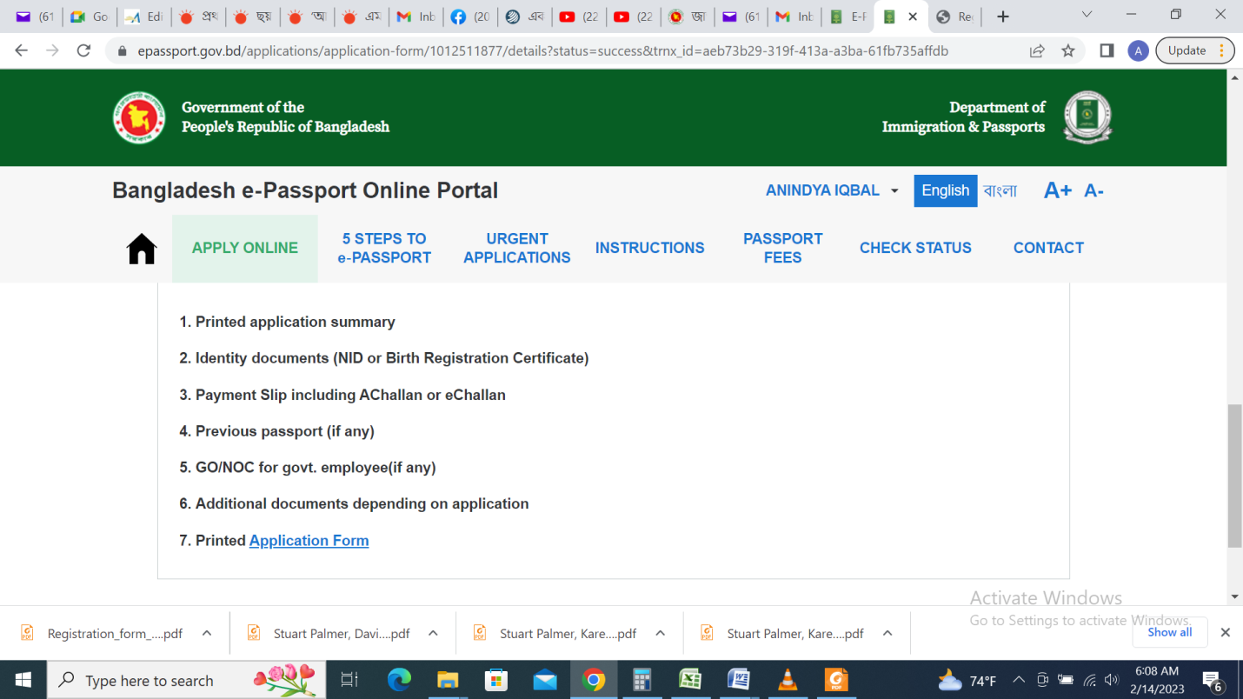
Online Passport Management System: another example of user suffering
No instruction for 3R photo for kids below 6 years.
Cost could have been reduced involving local collaborator and better maintenance could be ensured.

Slide 12
Consideration on Performance Issues
e-Nothi
Birth Registration
When and how hardware infrastructure design is prepared?
What about DevOps plan for rapid growth?
Is the software architecture appropriate?
Are standard optimization techniques such as message queue, caching, load balancing adopted?

Slide 13
How are local companies not being able to participate in projects funded by international partners?

Slide 14
Type-wise Analysis
Foreign funded
Type 1: International ERP such as SAP, Oracle, Microsoft Dynamics
Type 2: Software from scratch/customized by foreign vendor, often in collaboration with local one
Type 3: Developed from scratch by local software vendor
GoB funded
Type 4: Developed from scratch by local vendors

Slide 15
Surprising!
No explicit restrictive clause to select foreign vendors, yet…
eGP implementing complicated procurement rule was done by local company
EIMS, also a challenging one, was done by a local company
However, for the simple task of Data Collection of Poverty Affected people, an Armenian company was chosen who could not deliver in 4 years!!!
If it requires specialized experience such as smart NID printing, then it may be a different consideration
Possible issues
Over budget causing wastage for Bangladesh without assuring higher success probability
Huge turnover requirement or financial strength is prohibitive for local companies
Unnecessary foreign experience requirement

Slide 16
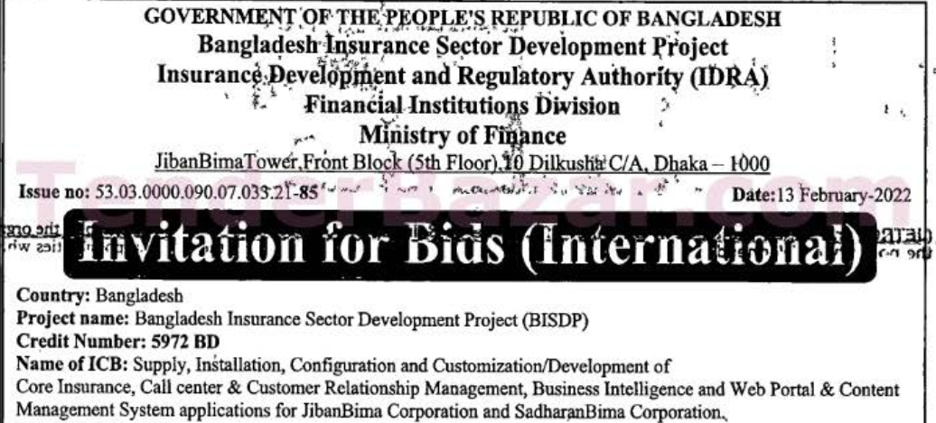
An Example

Slide 17
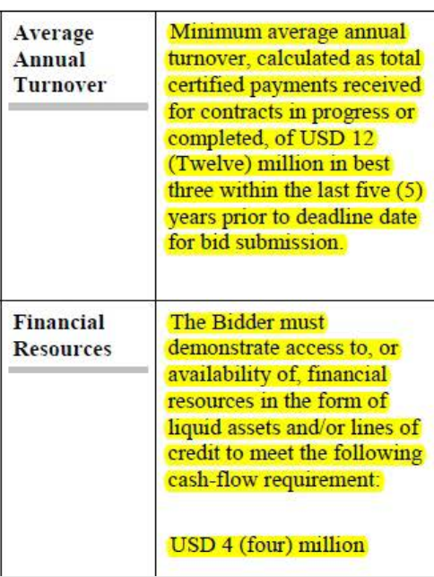

Slide 18
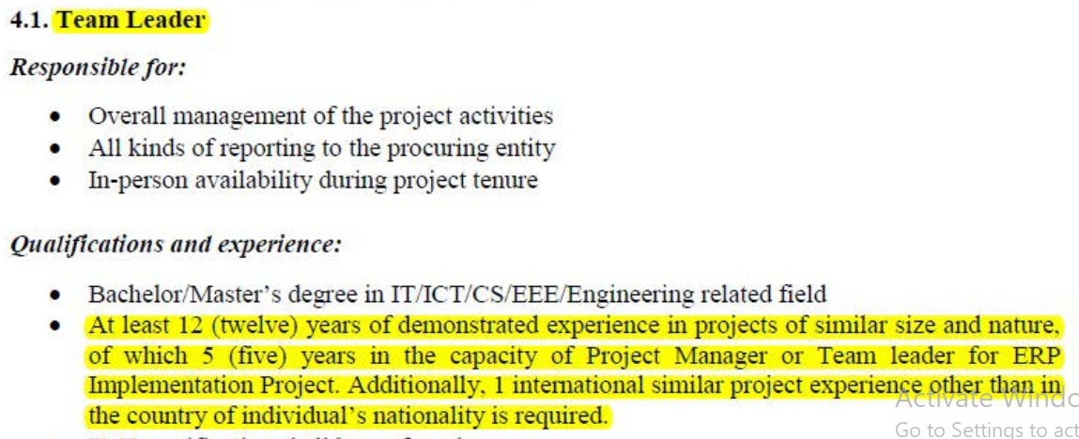

Slide 19
Proof of Ability of Local Software Industry in Private Sector (e.g. Financial)
In-house development at Islami Bank, Pubali bank
Local software at 10+ banks like Uttara bank, adaptation and significant expansion at Bank Asia
Core system of Nagad and Surecash, associated applications in bKash
Agent banking software at multiple banks

Slide 20
Challenges and Reasons for Failure?

Slide 21
Challenges of Planning a Software Project
Project planning: defining scope and accordingly schedule and budget
Scope determination needs considerable study
Too early to determine required hardware
Mindset of client: Could develop 3 modules in 4 years, now want to develop 12 modules in 2 years.
For man-month based budget estimation, appropriate project duration is important
Lack of transfer of experience from one agency to another which repeats same error across the agencies
Maintenance and sustainability plan
Is the in-house team ready to maintain? Bangladesh bank, some other banks and DSE could with enough manpower
Who will check and accept source code?

Slide 22
Challenges of Executing a Software Project
Vendor selection based on technical ability
Too many stakeholders such as:
Client
end user
project planner
design consultant
monitoring consultant
funding agency
Communication between developer and client/other stakeholders
Consultant’s limitation: often fail to
Prepare scope and budget
Guide on technical design issues like UX, DB design
Conduct performance and security test
Ensure coding standard to maintain software
Receive source code with technical understanding

Slide 23
Challenges with Implementation of International Software
Challenge with requirement collection: Language barrier and cultural understanding deficiency
Customizability: Not customizable often to satisfy local rules and practices
Implementation: Lack of long-term implementation support
Maintenance: Long-term maintenance challenge and huge cost (around 20% AMC)
Source code: Not available in most cases and so in-house modification is impossible
5-10 times higher cost
Fewer examples of success

Slide 24
Challenges with Home Grown Development
Poor planning of project: unrealistic scope, budget and schedule that does not allow vendor to engage sufficient resource
Vendor selection: Document evaluation based vendor selection in tendering process that does not reflect actual strength of the team
PPR rules: Current QCBS allows bidders with low technical mark win bids with low financial offer (example to follow)
Focus on outsourcing: Most of the top level local companies work for foreign market only
Issues from client: Local companies complain about not receiving bill in time, delay from client in implementation
Relevant question: comparison between in-house and vendor based development

Slide 25
Limitation of PPR
An example:
Budget 3 crore
Bidder with highest technical score got 80+, quoted 2.5 crore
2 other shortlisted bidders got slightly over 70, quoted around 1.2 crore
Eventually, the winner in QCBS could not re-fill resources when original team members left
PPR considers all types of projects in the same way, but the cost of a software project is entirely on manpower where wage vary from 50k to 4 lac.
Solution: Current practice of weighting price offer should be changed in QCBS

Slide 26
Maintenance and sustainability plan: Relieve from New Similar Project
Is the implementing agency capable of maintaining the system on their own?
Is source code usable by any new team? Was it understood and checked before acceptance?
How can transition from Project budget to Revenue budget be successful?
If they need continuous service from vendor, how will PPR accommodate continuous service from same vendor?

